Slide 2
The External Economic Action of the European Union and the Sustainable Development Goals
Filippo Fontanelli – University of Edinburgh – filippo.fontanelli@ed.ac.uk
University of Bologna
3 May – 25 May
15 May 2023
Energy and Investment Protection

Slide 3
Outline of the module (in progress)
The course’s basic coordinates
  Trade law, investment law and sustainable development: basic notions
  EU competences and policies in trade and investment law
Trade/investment obligations and non-trade values: the return of unilateralism
  The backlash against investor-State arbitration.
  The backlash against trade liberalisation
  Reform proposals for the global investment and trade regimes
  An overview of re-nationalisation trends in trade an investment (US, EU, UK, China)
    Anti-coercion
    Anti-circumvention
    Retaliate against non-MPIA
    Steel row, now sustainable
EU’s external economic action to raise standards abroad
  Free trade agreements and non-economic standards
    Conflict mineral regulation (sort of like diamonds)
    2022 commitment to green trade partnership
    Deforestation MERCOSUR
  Zoom-in: EU dispute with Korea on labour rights
  Zoom-in: level playing field and sustainable development in the Trade and Cooperation Agreement between the EU and the UK
    Mirror clauses
The Carbon Border Adjustment Mechanism
  Overview and assessment of the scheme
  Compatibility with WTO law (China’s complaint at WTO)
  Bonus: carbon removal
Energy (trade)
  EU Net Zero Industry Act and support to renewable energy industry (with assessment of WTO compatibility)
  Reaction to comparable foreign plans (US IRA)
  Zoom-in: biofuels and e-fuels
Energy (investments)
  Foreign investment protection and the fossil fuels industry
  Foreign investment protection and the nuclear energy industry
  Foreign investment protection and the renewable energy industry
  The Energy Charter Treaty, its reform attempts and the withdrawal of EU MS
Controlling trade and investment inbound and outbound flows
  Export restrictions and export controls (including coordinated action with US)
  Critical Raw Materials Act
  EU investment screening
Improving supply chains’ sustainability
  Friend-shoring and sustainable value chains
  Global supply chain due diligence proposal
  EU Guidance to Combat Forced Labor in Supply Chains
  Responsible forestry proposal (trade in forest-risk commodities)
  WTO law-compatibility of these schemes
Promotion of other social interests
  Non-paper of the Commission services 2017 TSD chatpers
  Gender balance in corporate governance in FTAs
  Protection of indigenous peoples’ rights
UNA Europa presentation

Slide 4

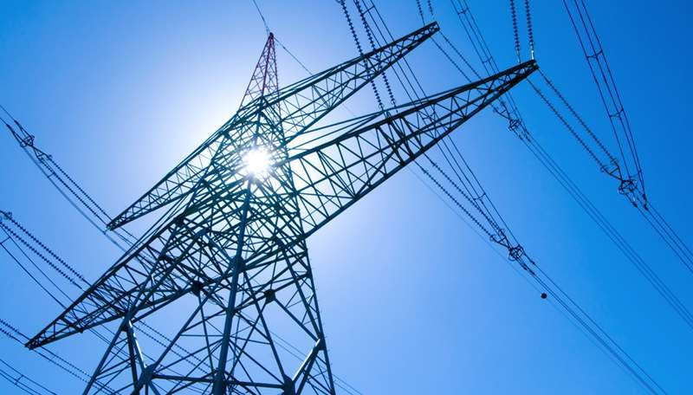
Outline
Investment protection
  Fossil fuels
  Nuclear energy
  Renewable energy
Energy Charter Treaty
  Disputes
  Modernisation
  Withdrawal
UNA Europa presentation

Slide 5
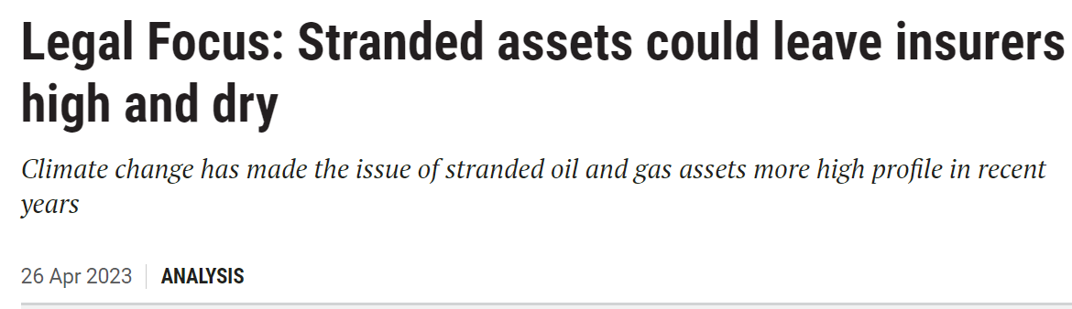
Energy investments, what’s going on?
UNA Europa presentation

Slide 6


Slide 7

Arbitration and energy
1951 Trucial Coast Arbitration
UNA Europa presentation

Slide 8
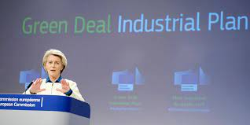
Green Industrial Policies and Investment Treaties
Treaty protection as insurance against regulatory changes? GIP’s effectiveness at risk
From Aisbett’s response to OECD consultation: https://www.oecd.org/investment/investment-policy/OECD-investment-treaties-climate-change-consultation-responses.pdf
UNA Europa presentation

Slide 9
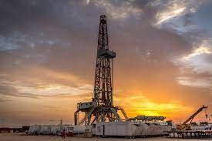
Attacking environmental measures
environmental restrictions on a coal-fired power plant (Vattenfall v. Germany, ICSID Case No ARB/09/06)
a moratorium on fracking (see Lone Pine v. Canada, ICSID Case No UNCT/15/2)
ban on offshore oil drilling (Rockhopper v. Italy, ICSID Case No ARB/17/14)
nuclear power phase-out (see Vattenfall v. Germany, ICSID Case No ARB/12/12)
coal phase-out (see Uniper v. Netherlands, ICSID Case No ARB/21/22)
UNA Europa presentation

Slide 10
Example
Ascent Resources Plc. and Ascent Slovenia Ltd. v. Republic of Slovenia, ICSID Case No. ARB/22/21
Ascent Resources submitted two notices of dispute to Slovenia – a first one in mid-2020, and a second one in May of 2022 – arguing that Slovenia had breached the Energy Charter Treaty (ECT) and the UK-Slovenia bilateral investment treaty (BIT).
The dispute centers on Slovenia’s decision that Ascent’s production of gas with the help of “low-volume hydraulic stimulation” at its Petisovci field required an environmental impact assessment, as well as the subsequent adoption of a hydraulic fracking ban by the state.
Compensation claimed: 500 mln EUR
Tribunal composed in March 2023
UNA Europa presentation

Slide 11
Lone Pine v. Canada
UNA Europa presentation

Slide 12
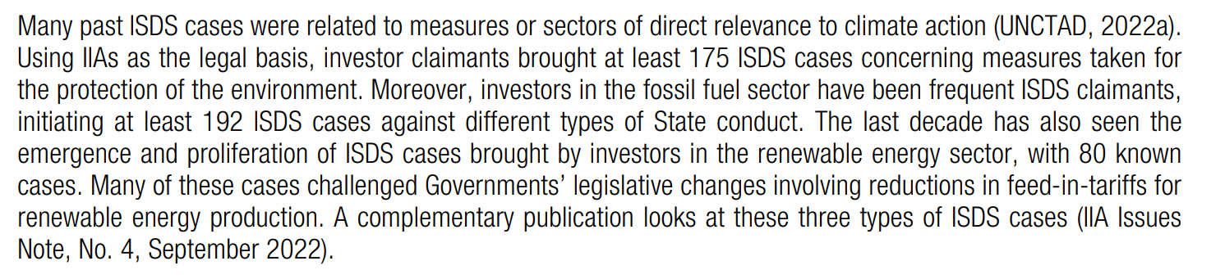
Taking stock: ISDS, energy and environment

Slide 13
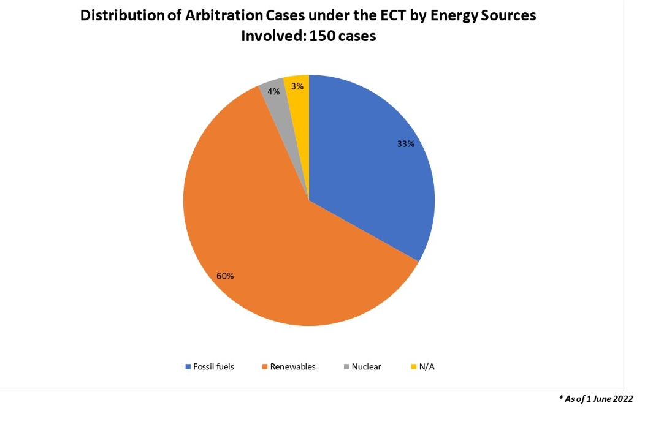
ECT and breakdown by industry

Slide 14
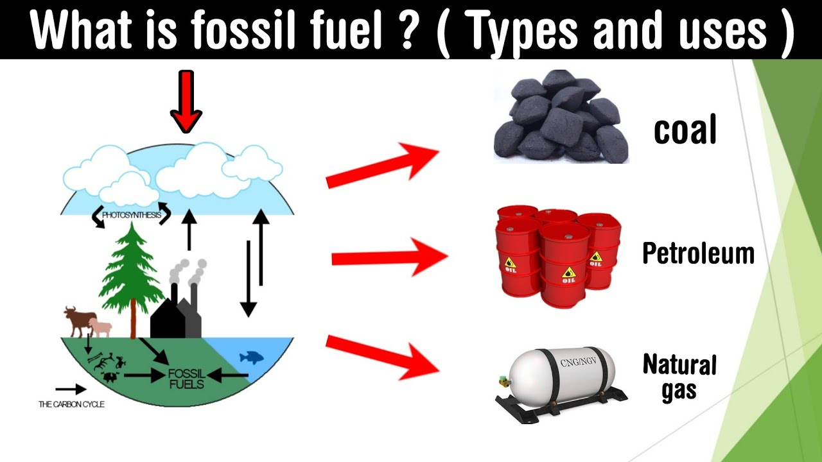
Fossil fuels

Slide 15
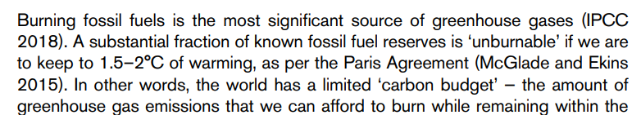
Work on reducing supply (not just demand)
From https://www.iied.org/sites/default/files/pdfs/migrate/17660IIED.pdf

Slide 16
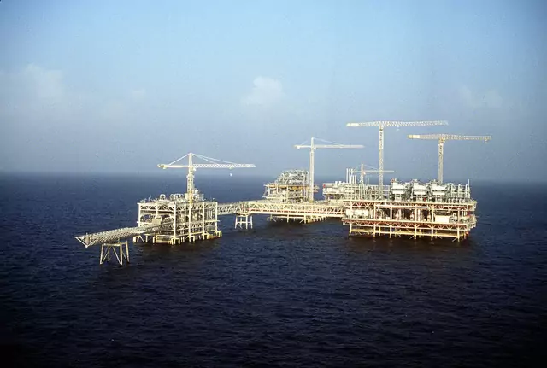
Asset-stranding
Resources invested are not used, because their use has become too expensive/illegal:
Extraction
Transportation
Distribution
From https://www.lse.ac.uk/granthaminstitute/explainers/what-are-stranded-assets/
UNA Europa presentation

Slide 17
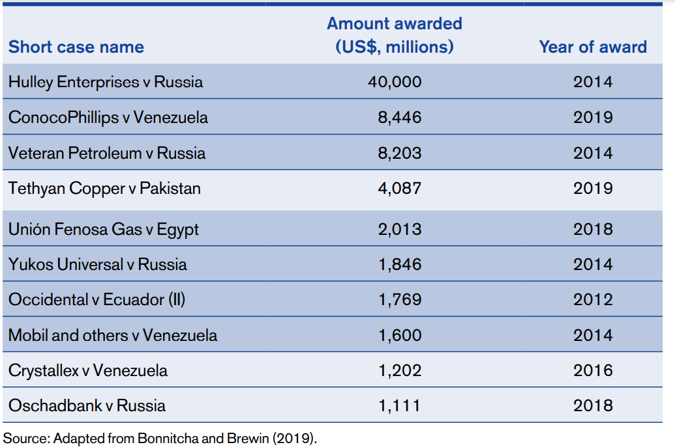
Big liabilities

Slide 18
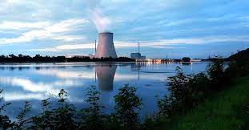
Nuclear energy

Slide 19
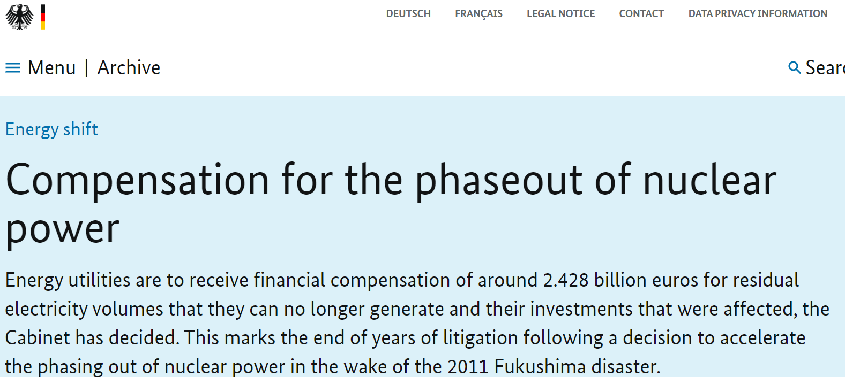
Domestic proceedings

Slide 20
Vattenfall settlement order
“this is not a case about the question whether Germany should or should not have nuclear power plants. Rather, this case is about the question whether owners of nuclear power plants should receive compensation for shutting down plants prior to the end of their economic life once a democratic decision has been made to end nuclear power generation”.

Slide 21
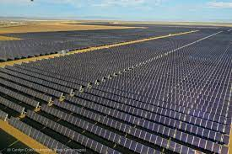
Renewable energies
Challenging adjustments in green initiatives (FITs)
FITs adopted in line with green goals – adjustments made to achieve economic sustainability
First discrete wave of claims against developed economies
UNA Europa presentation

Slide 22
2015 International Energy Charter
UNA Europa presentation

Slide 23

Discrete issues of renewable energy cases
Scope of legitimate expectations
Effects of general regulation (as opposed to individualised promises)
How to asses remaining profitability in proportionality assessment
Relevance of environmental concerns
Relevance of infra-EU nature
UNA Europa presentation

Slide 24
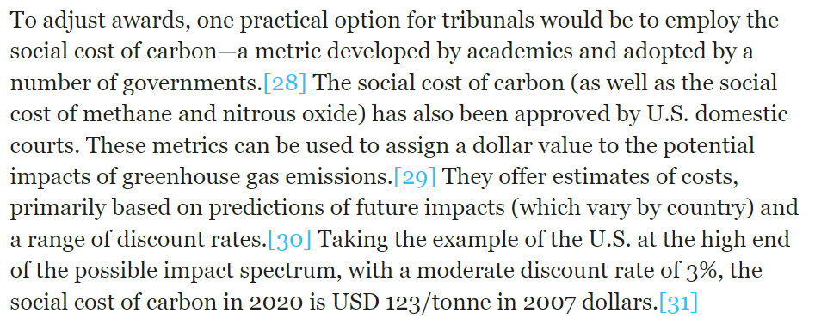
Adjusting awards?
From https://www.iisd.org/itn/en/2020/06/20/valuing-fossil-fuel-assets-in-an-era-of-climate-disruption/#_ftnref26
UNA Europa presentation

Slide 25
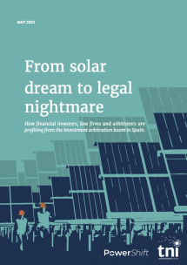

The Energy Charter Treaty
1994-1998
Technology-neutral
50 parties
BIT-like provisions, including ISDS
(as of 1 June 2022) 91 ECT cases (60% of ECT cases) on renewable power generation – not necessarily challenging environmental measures.
UNA Europa presentation

Slide 26

Backlash against ECT
2015 International Energy Charter
2017: modernisation process is undertaken
Modernised text adopted in 2022
UNA Europa presentation

Slide 27

Modernisation focus
  Definitions (green products)
  Carve-out for fossil fuels? Low uptake
  Substantive standards clarified
  Security for costs possible
  Valuation of damages
  Third-party funding,
  Sustainable development and CSR

Slide 28
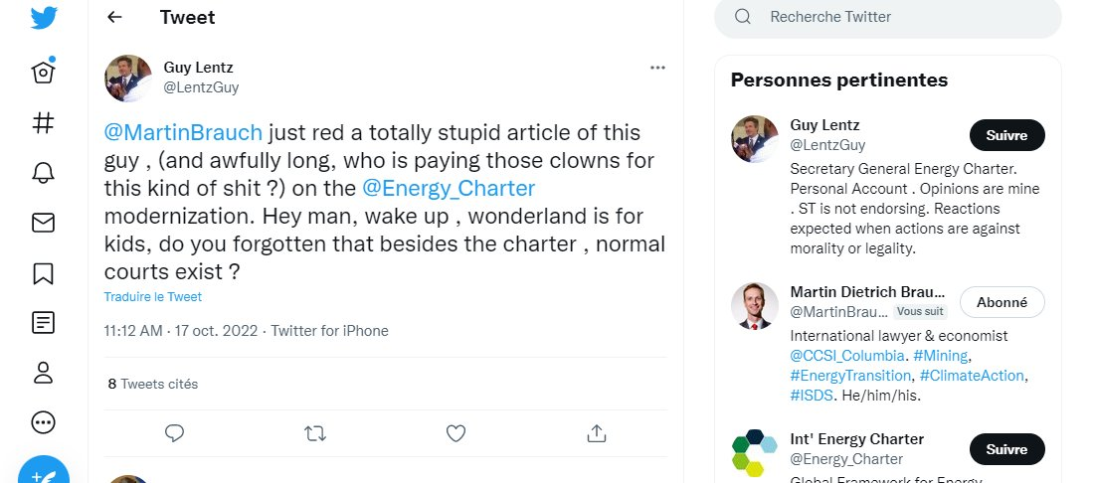

Modernisation low-lights
  ‘each Contracting Party shall … effectively implement the UNFCCC and the Paris Agreement adopted thereunder, including its commitments with regard to its Nationally Determined Contribution’,
  instead:
  ‘reaffirm[ed] [each contracting party’s] respective rights and obligations under multilateral environmental and labour agreements to which it is a party, such as … the UNFCCC, the Paris Agreement’.

Slide 29


Withdrawals
Article 47: a contracting party can notify its withdrawal from the ECT under the following conditions:
• If the 5-year initial duration since entry into force for a contracting party has passed.
• With a 1-year notice period for withdrawal to take effect.
• Subject to a sunset or survival clause of 20 years for investments made until the effective date of withdrawal.
UNA Europa presentation

Slide 30
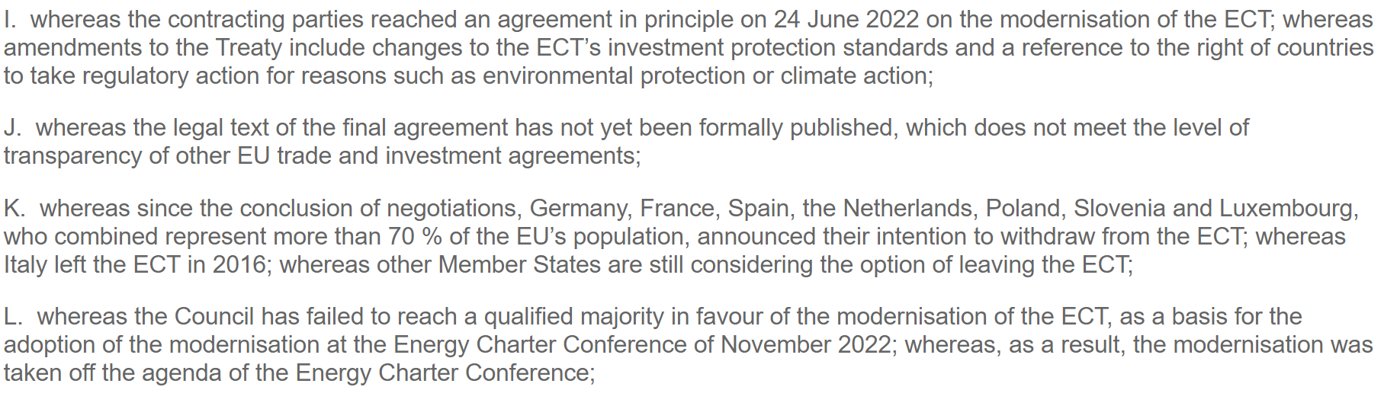
Parliament November 2022

Slide 31
Parliament’s view
the final text of the modernised ECT … is not aligned with the Paris Agreement, the EU Climate Law or the objectives of the European Green Deal, is not in line with the objectives laid down by Parliament in its resolution of 23 June 2022 on the future of EU international investment policy, including, most notably, the immediate prohibition of fossil fuel investors from suing contracting parties for pursuing policies to phase out fossil fuels, in line with their international commitments, the significant shortening of the time frame for phasing out the protection of existing investments in fossil fuels, and the removal of the ISDS mechanism

Slide 32
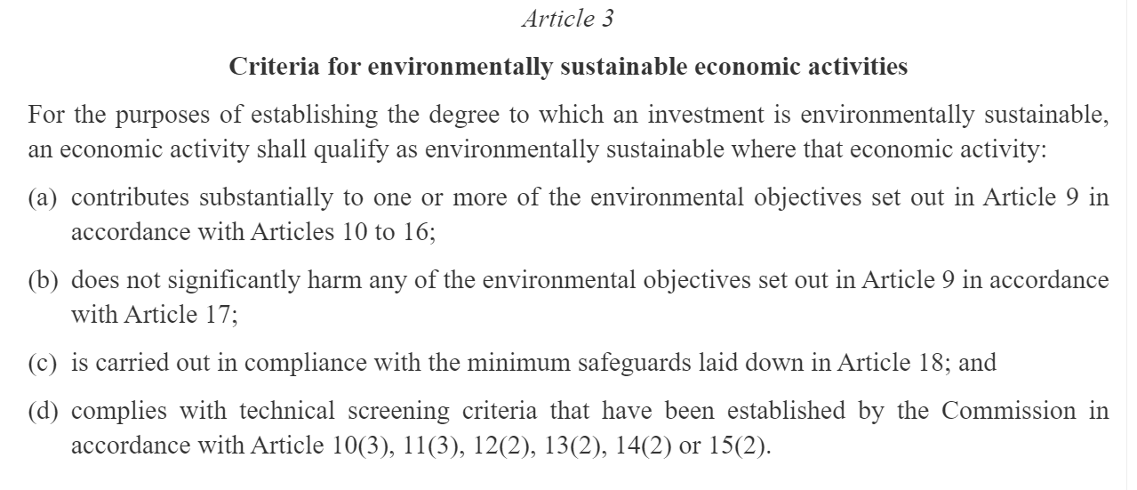
Sustainable finance criteria
UNA Europa presentation

Slide 33
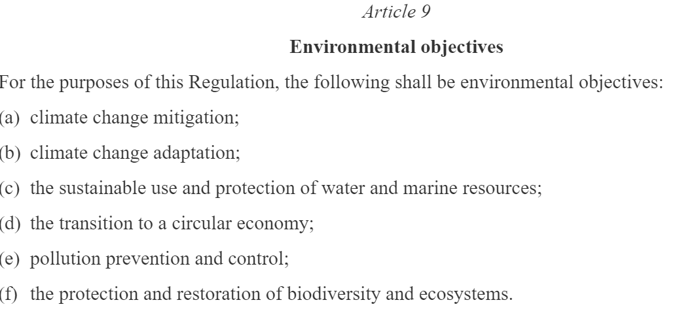
UNA Europa presentation

Slide 34
@una_europa
#Una_Europa
Thanks!

